Slide 1

REVENUE INSIGHTS IN HOSPITALITY DOMAIN
-A Data-Driven Approach to Revenue Optimization

Slide 2
Challenges in Hospitality Revenue Management
Lack of real-time revenue tracking
Difficulty in understanding booking trends and room utilization
Need for efficient forecasting and optimization
Inconsistent performance evaluation across different time frames

Slide 3
Understanding Revenue Trends in the Hospitality Industry
The hospitality industry faces challenges in tracking revenue, optimizing room occupancy, and forecasting demand.
Hotel managers struggle with:
Inconsistent room pricing strategies.
Inefficient utilization of available rooms.
Difficulty in identifying revenue trends.
Lack of actionable insights for decision-making.
This dashboard aims to address these challenges using Power BI for real-time revenue analytics.

Slide 4
Key Goals of the Dashboard
Monitor revenue performance using key hospitality metrics (RevPAR, ADR, DURN, etc.).
Analyze MoM & WoW trends to track revenue fluctuations.
Improve room utilization rates by understanding booking patterns.
Enable dynamic filtering for better decision-making.
Enhance forecasting capabilities for profitability.

Slide 5
Step-by-Step Approach to Dashboard Development
Data Collection & Cleaning
Imported datasets (fact & dimension tables) into Power BI.
Cleaned and transformed data using Power Query (removed duplicates, standardized dates, and merged datasets).
Data Modeling & DAX Calculations
Established relationships between fact and dimension tables.
Created DAX-based KPIs such as RevPAR, ADR, Occupancy Rate, MoM & WoW changes.
Dashboard Visualization & Interaction
Designed interactive charts, KPIs, slicers, and heatmaps for real-time insights.
Enabled dynamic filtering by date range, hotel location, and room types.
Testing & Business Insights
Validated DAX calculations and ensured data consistency.
Provided key business takeaways for improving revenue strategies.

Slide 6
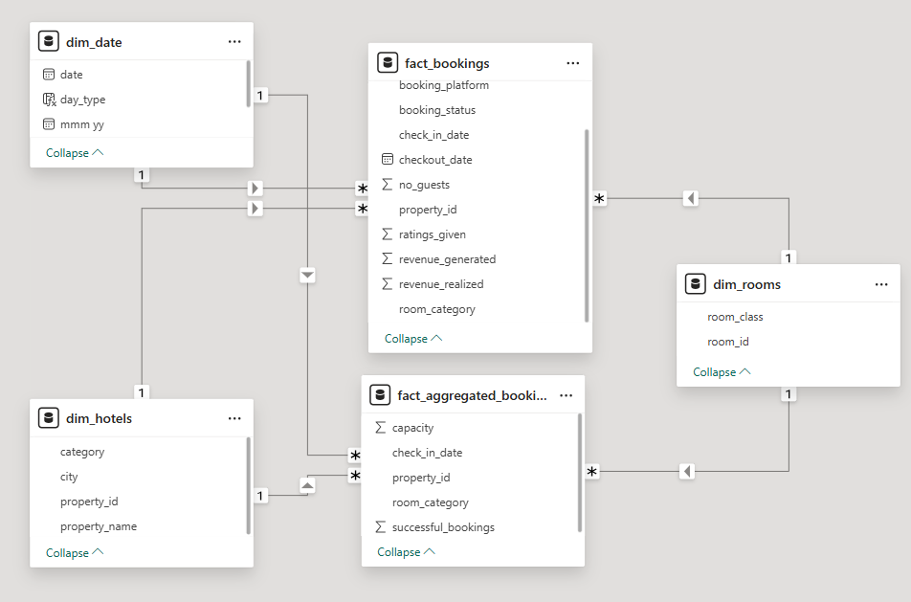
Structuring the Data for Accurate Insights

Slide 7
Dashboard Features
Key Insights from the Dashboard
Description:
Dynamic Date Filtering: Compare performance across different timeframes
Revenue Breakdown: Detailed insights on ADR, RevPAR, and Utilization Rates
Trend Analysis: MoM & WoW comparisons for revenue growth tracking
Interactive Visuals: Charts, heatmaps, and slicers for user-friendly analysis

Slide 8
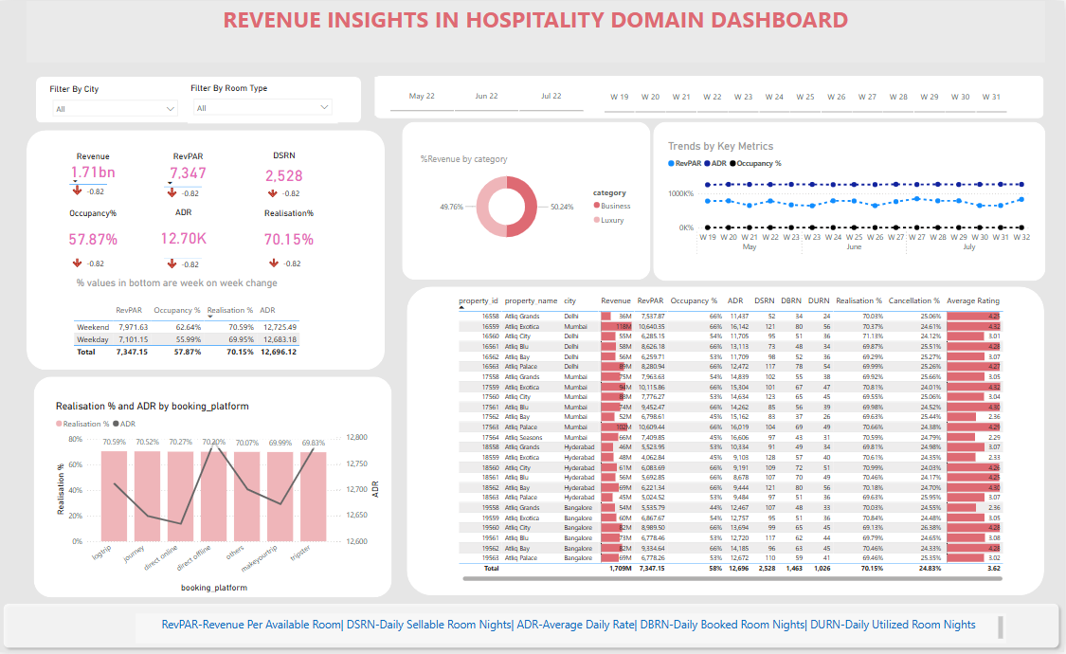
DASHBOARD INSIGHTS

Slide 9
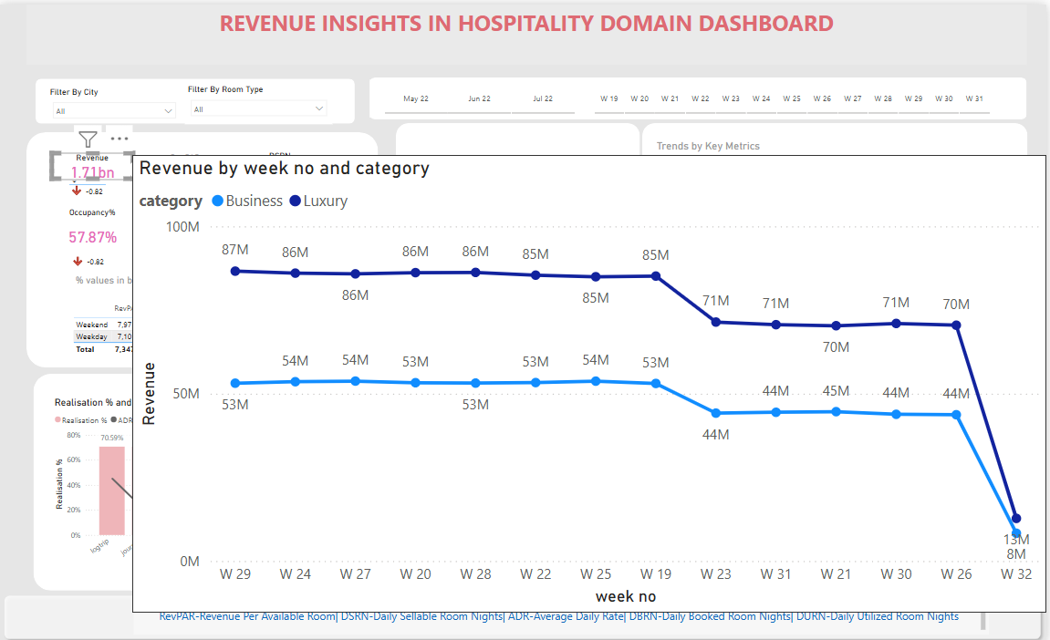

Slide 10
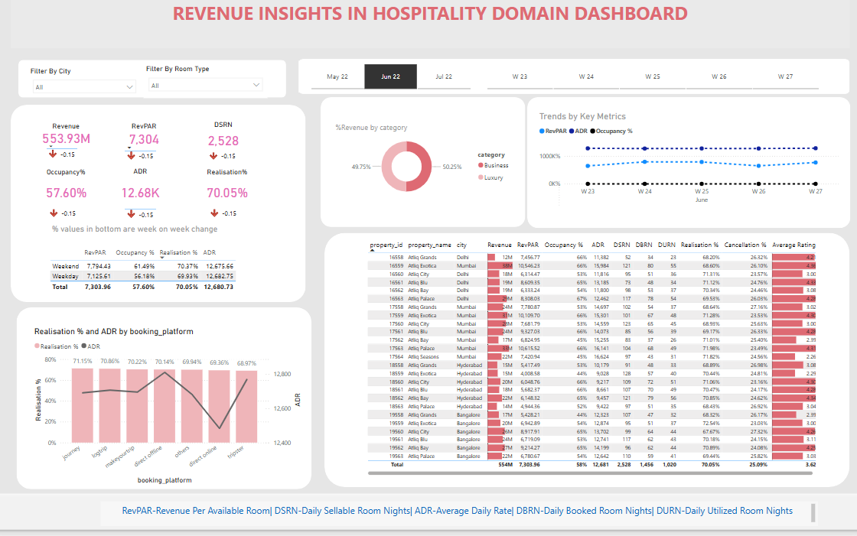
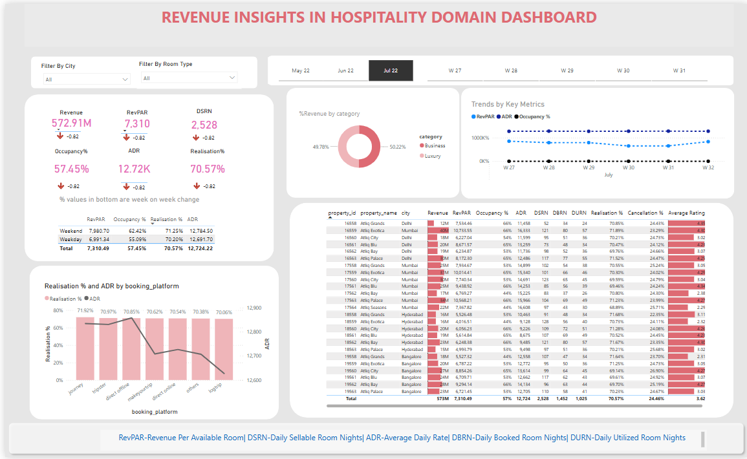
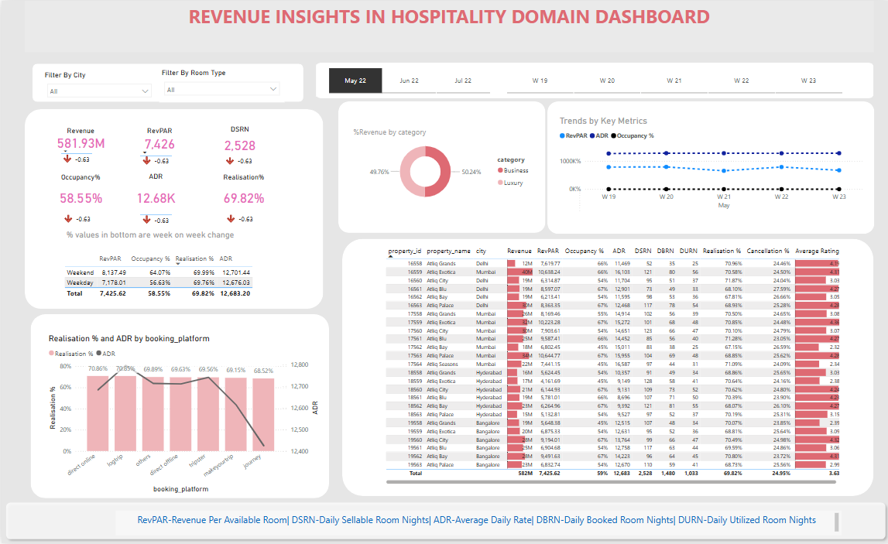

Slide 11
Benefits & Business Impact
Improved Revenue Tracking: Better insights into revenue streams
Enhanced Decision-Making: Real-time MoM & WoW comparisons
Optimized Room Utilization: Increased efficiency in pricing and booking
Data-Driven Strategy: Strategic planning for revenue growth

Slide 12
Conclusion & Future Scope
Conclusion:
The dashboard provides a comprehensive view of revenue performance
Helps in tracking business KPIs effectively
Enables better forecasting and decision-making
Future Enhancements:
Adding AI-based predictive analytics
Expanding scope to include competitor analysis
Integrating customer sentiment analysis for better pricing strategies

